Slide 1

Silver Oak Institute of Technology Bachelor of Technology Department of Computer Engineering (05)
Student Services Chatbot System
Group Members
Internal Faculty Guide
PROF. VISHWAS SHARMA
KALSARIYA JAYRAJ H. 2201030400040
GADHER CHIRAG N. 2201031800013
CHOVATIYA HARSHIL S. 2201030400017
GADARIYA BHUPENDRASINGH S. 2201031800051

Slide 2
Table of Content
Abstract
Introduction
Literature Survey/Research
Proposed Work
Diagram(UML)/Wireframe
Worked carried out till date(Table format)
Timeline Chart(Gantt Chart)
Future Work & Conclusion
References

Slide 3
Abstract
The University Chatbot project is focused on developing an chatbot that can assist students by providing quick and accurate responses to queries about various university-related topics such as admissions, course schedules, fees, and campus events. By using natural language processing (NLP) techniques, the chatbot can handle repetitive questions, improving efficiency for both students and university staff. The chatbot will be available 24/7, ensuring seamless communication and improving student experience.

Slide 4
Introduction
Universities receive a high volume of inquiries from students, ranging from admissions questions to exam schedules. Handling these queries manually can be time-consuming and costly. A chatbot offers an automated solution to this challenge by acting as a virtual assistant. By integrating with university databases, the chatbot can provide real-time information to students at any time, reducing the workload on administrative staff and improving student satisfaction.

Slide 5
Literature Survey/Research
Various universities have already implemented chatbot solutions to enhance student engagement. For example, Pounce, developed by Georgia State University, assists students with enrollment and financial aid queries. Another example is Deakin University’s Genie, which is designed to handle academic-related questions. These systems have been shown to improve response time and reduce administrative overhead. Additionally, the growth of AI and NLP

Slide 6
Proposed Work
The proposed chatbot will be developed using AI and NLP to understand and respond to student queries. It will be integrated with the university’s existing databases, such as the admission portal, course schedules, and events calendar. The chatbot will support both voice and text-based interactions. Initially, the chatbot will focus on answering frequently asked questions, and over time, it will be improved to handle more complex inquiries. We plan to implement the chatbot using platforms like Google Dialogflow or Microsoft Bot Framework for easy integration with various messaging platforms and websites.

Slide 7
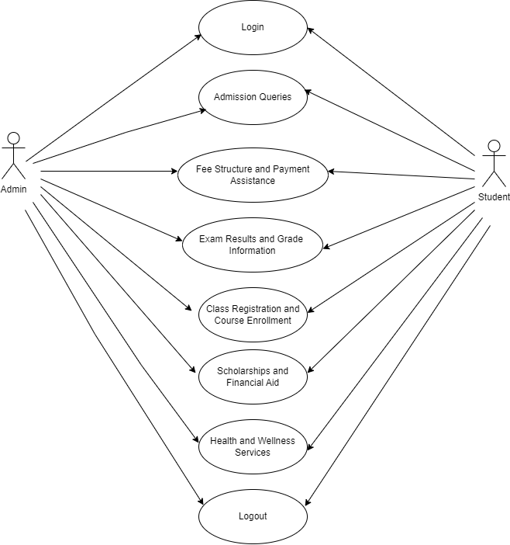
Diagram(UML)/Wireframe

Slide 8
Work carried out till date
Task | Description | Status | Completion Date
Project Kickoff | Project officially started | Completed | 22/08/2024
Research & Literature Review | Collected and reviewed relevant research on chatbots | Completed | 01/09/2024
Requirements Gathering | Identified key functionalities and user needs | Completed | 05/09/2024
UML Diagrams | Designed UML diagrams for chatbot architecture | Completed | 12/09/2024
Technology Stack Selection | Chose programming languages, platforms, and frameworks | Completed | 14/09/2024
Web Development | Developing the chatbot’s web interface | In Progress | Ongoing
Backend Development | Development of backend logic, database setup, and NLP integration | Not Started | -
Integration with University Website | Integrating chatbot features into the university website | Not Started | -
Testing and Feedback (Initial) | Initial testing with small user group to check core functionalities | Not Started | -
User Acceptance Testing (UAT) | Final testing with a broader user group for feedback and refinement | Not Started | -
Deployment | Deploying the chatbot to the live university website | Not Started | -
Launch | Official launch of the chatbot for student use | Not Started | -

Slide 9
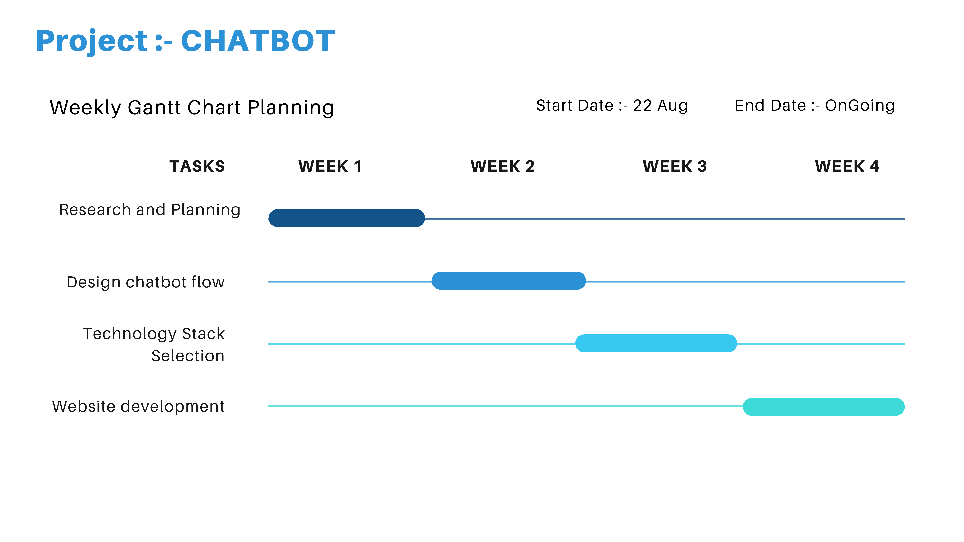
Time line chart(Gantt Chart)

Slide 10
Future Work & Conclusion
Future work :
Test the chatbot in a live environment with real students.
Gather feedback and improve the chatbot’s responses.
Implement advanced features such as voice recognition and personalized recommendations.
Conclusion :
The university chatbot project will significantly reduce the administrative burden while improving the overall student experience. By providing accurate, real-time information to students, the chatbot can help universities manage a large volume of inquiries efficiently.

Slide 11
References
EduChat: An AI-Based Chatbot for University-Related Information (2023) explores the use of AI and machine learning to develop chatbots for universities. The system, EduChat, integrates a hybrid approach using both rule-based methods and machine learning to answer queries related to admission, courses, and student life​(MDPI).
Investigating Student Acceptance of an Academic Advising Chatbot (2023) studies how students engage with academic advising chatbots in higher education institutions, focusing on technology acceptance and user experience. This is particularly relevant to understanding how your chatbot can effectively provide academic support​(SpringerLink).
Design and Development of an Advising Chatbot for Student Support (2023) discusses the creation of chatbots aimed at helping students navigate academic advising, providing insights into chatbot design that ensures smooth interactions for tasks like course registration and fee inquiries​(SpringerLink).

Slide 12
Thank You..!
13
Any Questions?

